Slide 1



Iot based two side safety vehicles
Team BIT BY BIT

Slide 2
Team Members
Punith Kumar P R
Shashank S P
Yogith G
Swetha L

Slide 3
Problem Statement
Pedestrian deaths account for around 30% of all deaths from road traffic crashes in India. In some large Indian cities the proportions of pedestrians killed is up to 60% of all road traffic deaths.
One serious road accident in the country occurs every minute and 16 die on Indian roads every hour. Around 1214 road crashes occur every day in India.

Slide 4
Solution / idea overview
As a solution to the above problem, we are developing an lOT system that can be implemented in vehicles to avoid the chances of accidents and damage caused by those accidents to pedestrians.
It is also likely to prevent the vehicle to hit the other obstacles and In case of accidents due to rash driving if the vehicle tilts or if vehicles hit by other vehicles system
immediately stops the wheels which prevents the further drift of the vehicle.
If accident is caused, system notifies and sends the accident location to the emergency number.

Slide 5
Solution / idea overview
As a solution to the above problem, we are developing an lOT system that can be implemented in vehicles to avoid the chances of accidents and damage caused by those accidents to pedestrians.
In case of accidents due to rash driving or if the vehicle crashes into the obstacle, the system immediately stops the wheels which prevents the further drift of the vehicle.
If accident is caused, system notifies and sends the accident location to the emergency number.

Slide 6
Tech Stack
Hardware components
TTGO TCALL SIM 800L
(ESP32 + SIM module)
PIR Motion Sensor
Tilt Sensor
Ultrasonic Sensor
Impact switch
Motor Driver/ Motor
LCD Display
Buzzer
Technologies
Internet of Things(IoT)
Software Application
Arduino IDE
Embedded C/C++

Slide 7
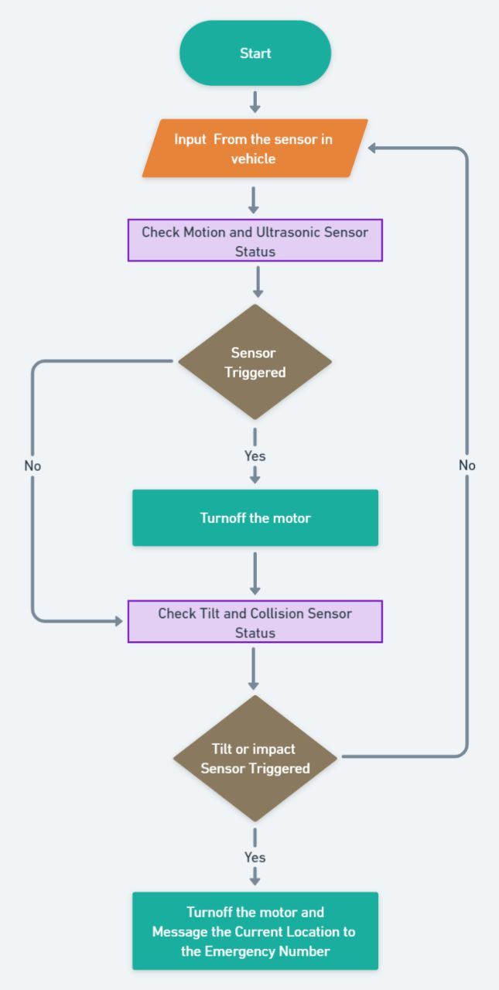
System flow diagram

Slide 8
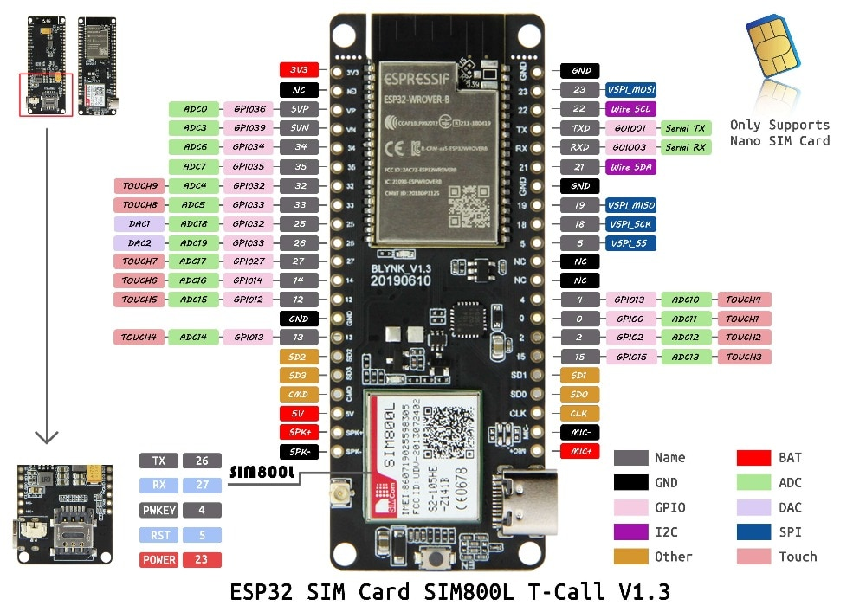

Slide 9
THANK YOU

